Slide 1
The Intersection of African Culture and IT: Importance of Gender Awareness
PRESENTED BY PAUL NDEGE

Slide 2
INTRODUCTION
Africa is a continent rich in culture and tradition. Information Technology (IT) is a rapidly growing field with the potential to transform lives across the continent. However, cultural norms can sometimes create barriers to women's participation in IT. This presentation explores the importance of gender awareness in ensuring equitable access to the opportunities presented by IT in Africa.

Slide 3
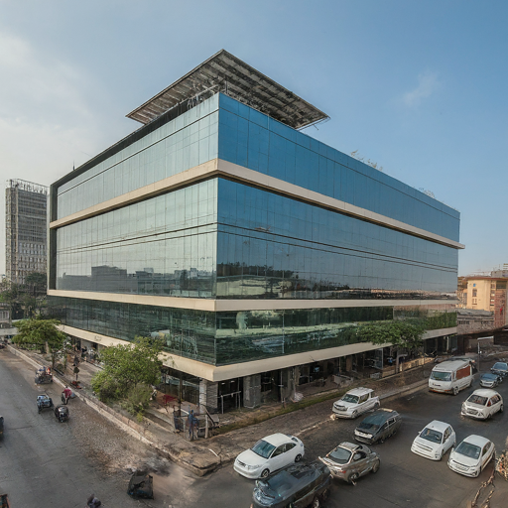
The Rise of IT in Africa
Africa is experiencing a rapid growth in IT infrastructure and adoption.
Mobile phone penetration is high, creating opportunities for mobile-based solutions.
Increased internet access is opening doors for e-commerce, education, and communication technologies.
The rise of IT in Africa presents tremendous opportunities for economic growth, social development, and improved access to information. However, it's crucial to ensure that these benefits are shared equally by both men and women.

Slide 4
A Rich Tapestry: African Culture and Its Values
Africa boasts a vibrant and diverse cultural heritage.
Communalism: A core value emphasizing shared resources and collective responsibility.
Africa is a continent brimming with rich and diverse cultural traditions. These traditions have profoundly shaped societies for centuries and continue to influence various aspects of life, including the realm of Information Technology. One key value that resonates strongly is communalism. This philosophy emphasizes shared resources and collective responsibility, fostering a collaborative spirit that aligns perfectly with the open-source software development model.

Slide 5
African Innovation: Ubuntu - A Collaborative Spirit
Ubuntu (South Africa): Open-source software project built on community collaboration.
Communal values translate to IT practices, fostering inclusivity.
A prime example of how African values translate into the IT world is Ubuntu, a prominent open-source operating system hailing from South Africa. Ubuntu thrives on a collaborative development model, where programmers from across the globe contribute their expertise. This approach embodies the spirit of communalism, promoting inclusivity and community-driven innovation within IT ecosystems.

Slide 6
Gender Awareness in African Society
Gender roles and norms have historically shaped social dynamics in Africa.
However, there's a growing recognition of the importance of gender equality, especially in technological advancements.
Initiatives like the African Girls Can Code Programme (Rwanda) empower young girls with coding skills, bridging the gender gap in IT education and workforce participation.
Historically, gender roles and norms have significantly influenced social dynamics within African societies. However, there's a growing awareness of the importance of gender equality, particularly when it comes to technological advancements. Initiatives like the African Girls Can Code Programme, spearheaded by the Rwandan government, aim to empower young girls with coding skills. This initiative tackles the gender gap in IT education and workforce participation, paving the way for a more inclusive tech landscape.

Slide 7
Gender-Inclusive Innovation
Gender awareness is crucial for social justice and driving innovation.
Diverse teams are more creative and effective problem solvers.
Companies like Andela (Nigeria) leverage diverse talent for cutting-edge solutions.
Gender-inclusive innovation ensures tech addresses everyone's needs.
Promoting gender awareness in IT goes beyond social justice; it's a strategic imperative for driving innovation and sustainable development. Studies have shown that diverse teams, comprising individuals of different genders, backgrounds, and perspectives, are more creative and effective problem solvers. African tech companies like Andela, based in Nigeria, understand this. They actively foster inclusivity and gender diversity to harness the collective intelligence of their talent pool. This allows them to develop cutting-edge solutions that address local and global challenges. Moreover, gender-inclusive innovation ensures that technological advancements address the needs and priorities of all members of society, leading to more impactful and sustainable outcomes.

Slide 8
Real-World Examples - Rebecca Enonchong
African women are making significant contributions to the IT sector.
Rebecca Enonchong, founder of AppsTech, is a leading figure advocating for gender equality and digital literacy.
Her efforts have empowered countless women to pursue careers in IT and entrepreneurship, shaping the future of technology on the continent.
African women are making remarkable strides in the IT sector, challenging stereotypes and driving meaningful change. One such example is Rebecca Enonchong, the founder of AppsTech. She's a leading figure in Africa's tech scene, passionately advocating for gender equality and digital literacy. Her tireless efforts have paved the way for countless women to pursue careers in IT and entrepreneurship, empowering them to shape the future of technology on the continent.

Slide 9
Conclusion
The intersection of African culture and IT presents a unique opportunity for gender awareness and equality.
By embracing diverse perspectives and fostering inclusivity, we can harness technology's full potential to address challenges facing African societies.
Let's strive to create a future where gender equality is a fundamental principle and a driving force for innovation and progress in IT.
In conclusion, the intersection of African culture and Information Technology presents a unique opportunity to promote gender awareness and equality. By embracing diverse perspectives and fostering inclusivity within the IT landscape, we can unlock technology's full potential to address the complex challenges facing African societies. As we move forward, let's strive to create a future where gender equality is not just a fundamental principle but also a driving force for innovation and progress in the ever-evolving world of IT.

Slide 10


